Slide 1
Hackthissite Application Challenge 3
Group6-1051409 張峻維

Slide 2
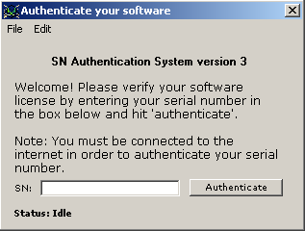

Slide 3
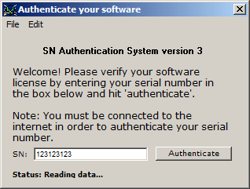

Slide 4
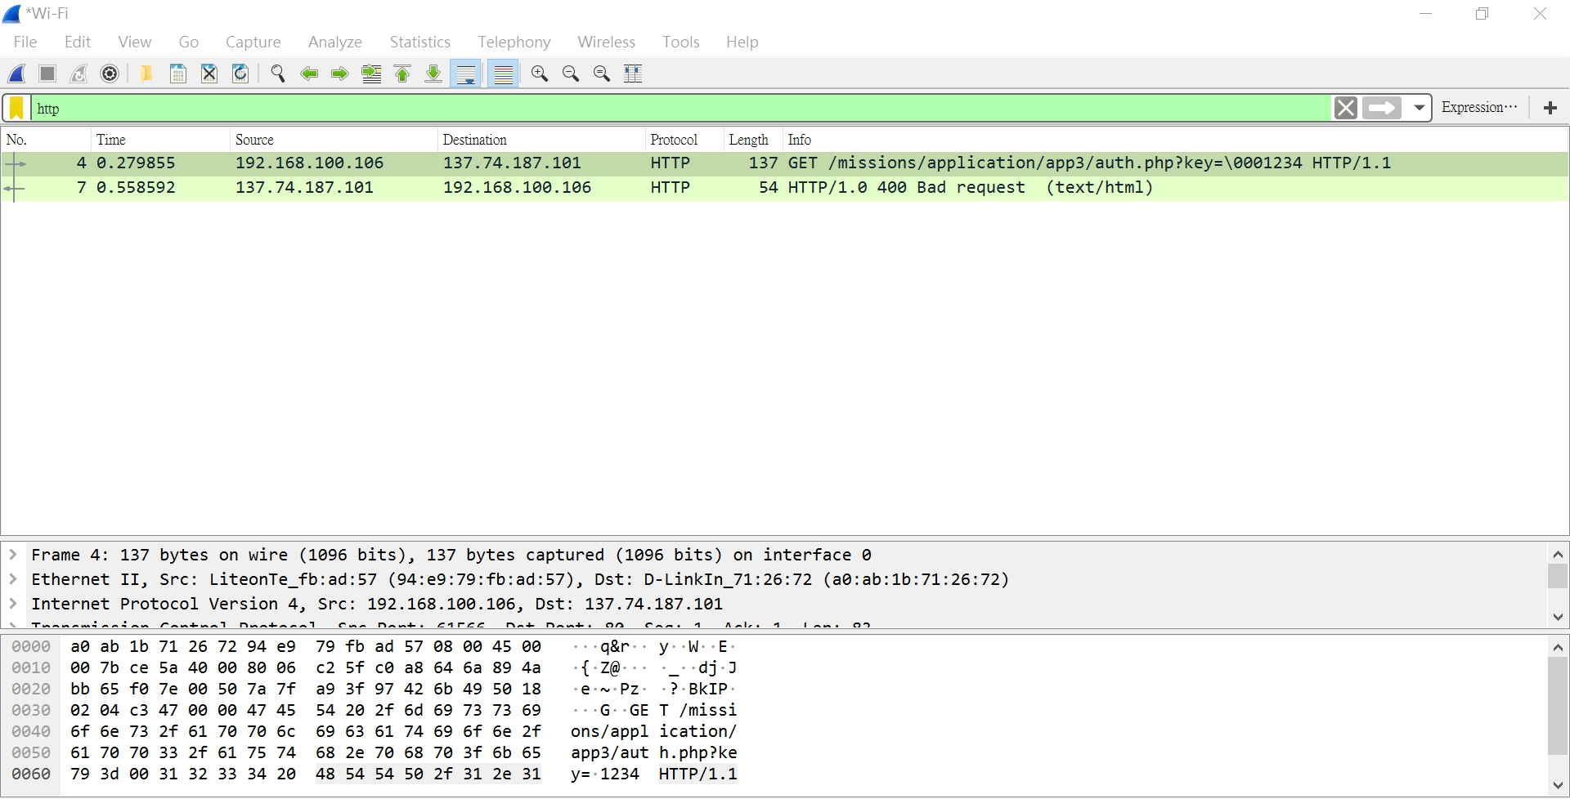

Slide 5
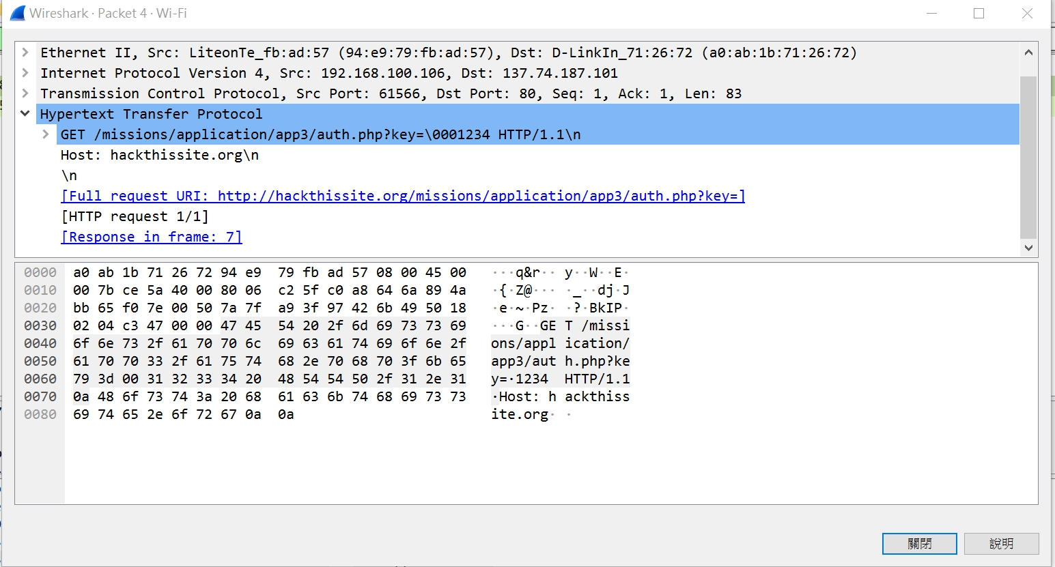

Slide 6
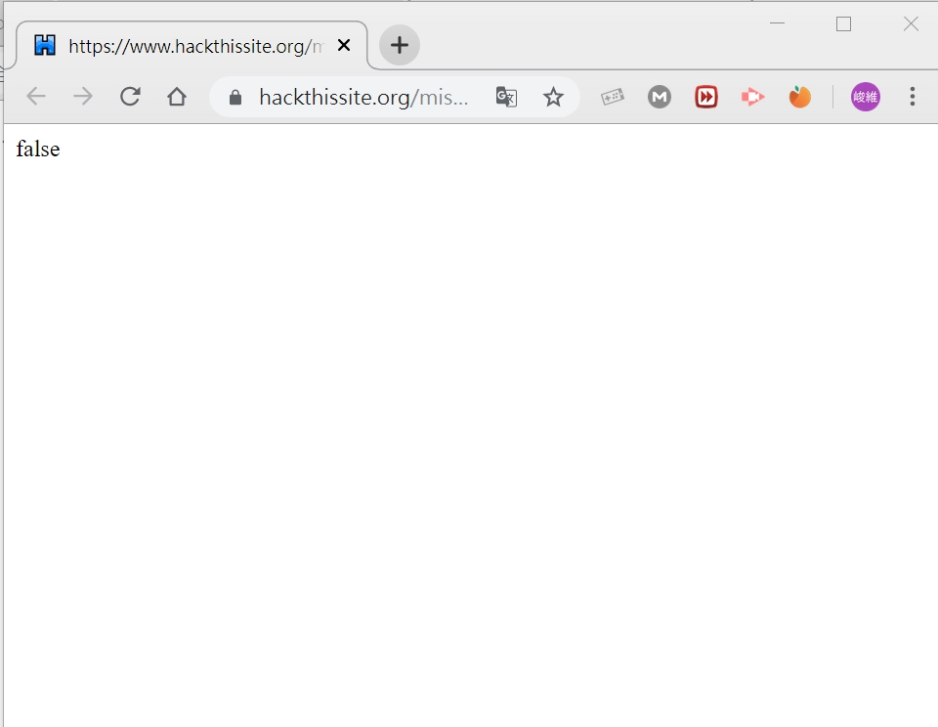

Slide 7
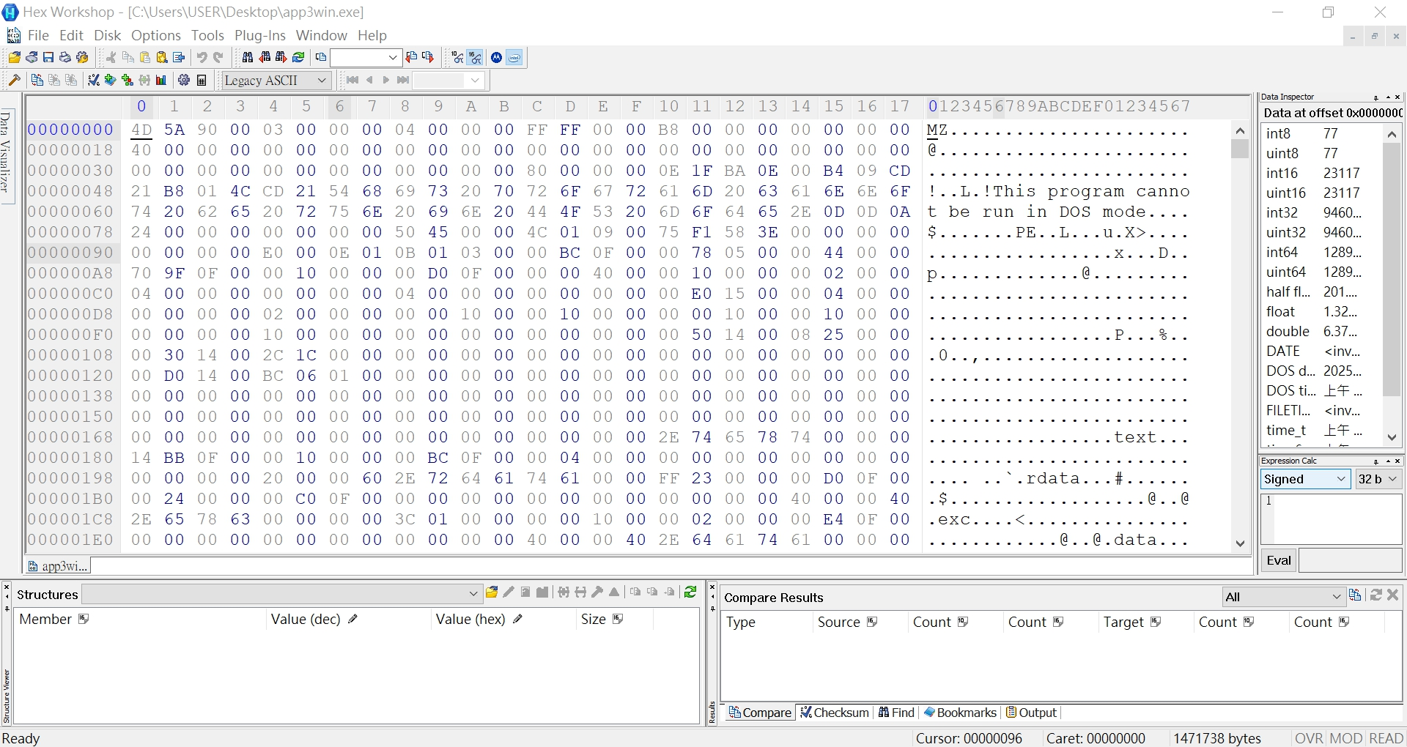

Slide 8
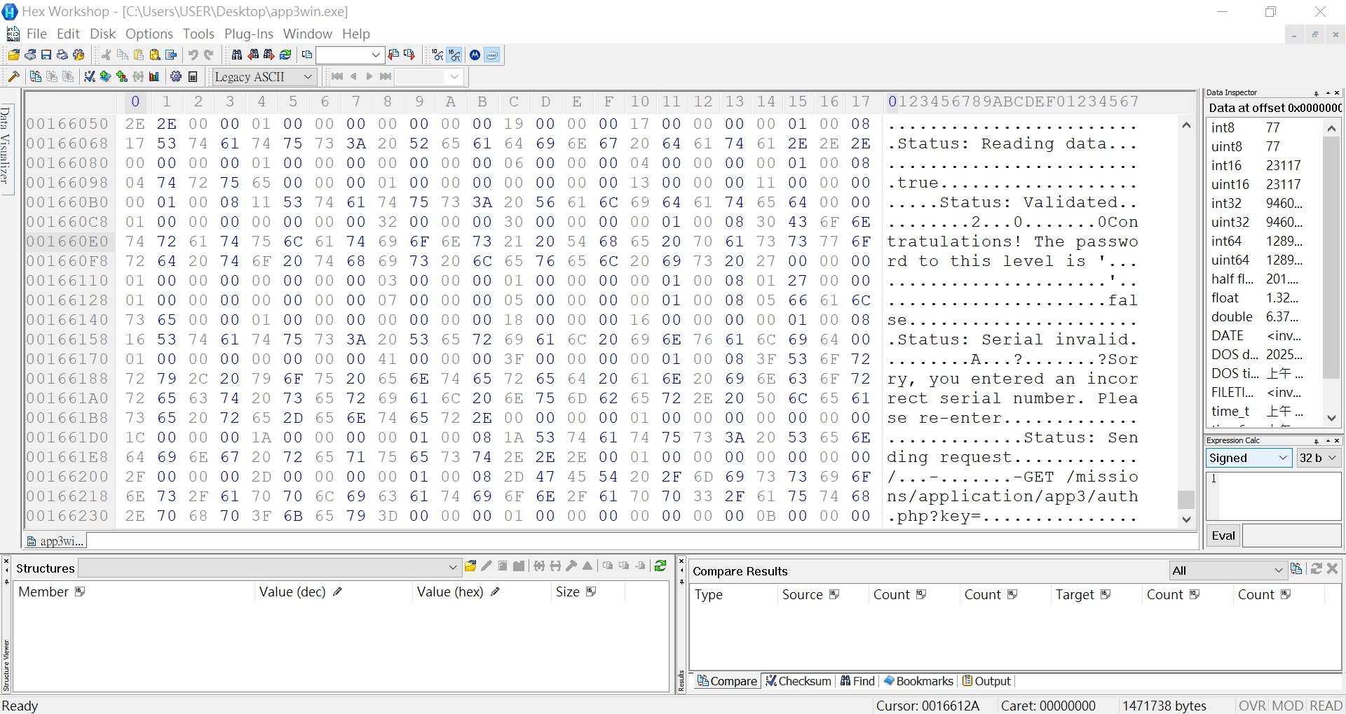

Slide 9
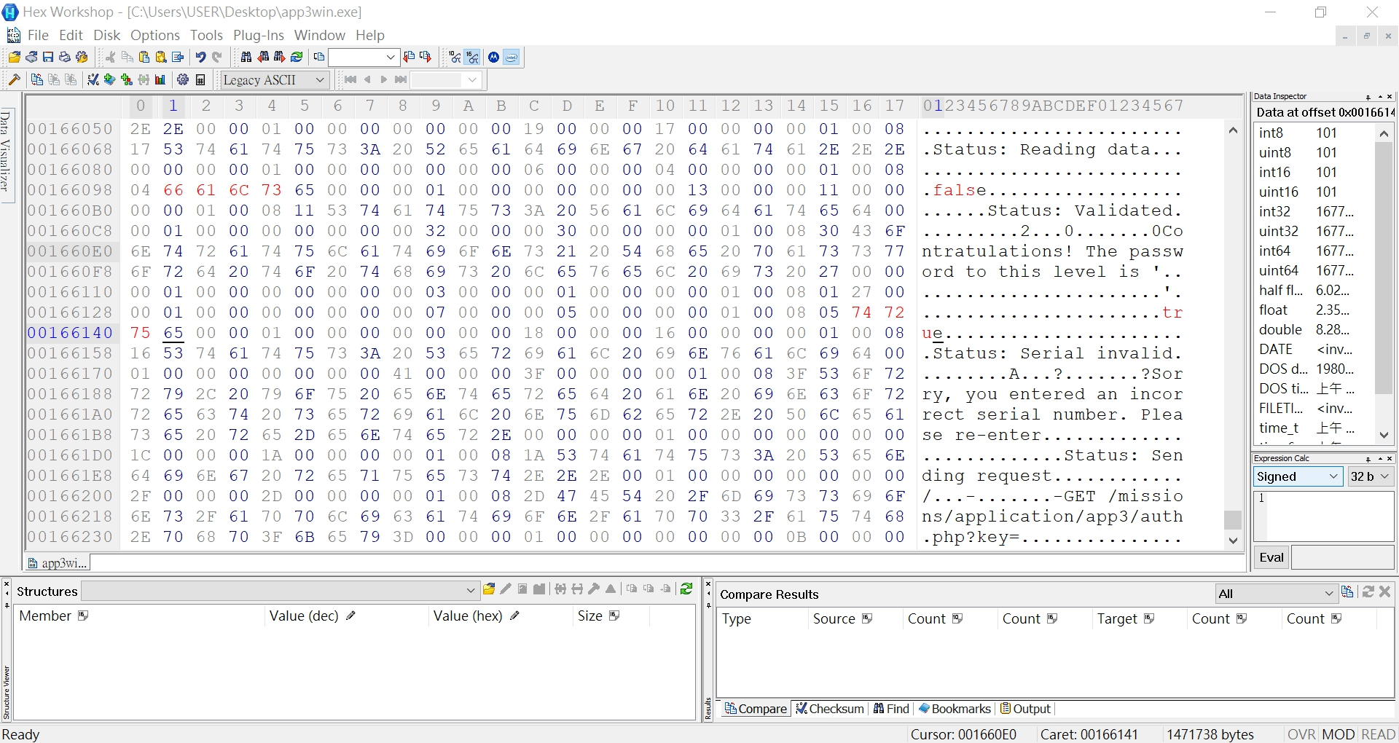

Slide 10
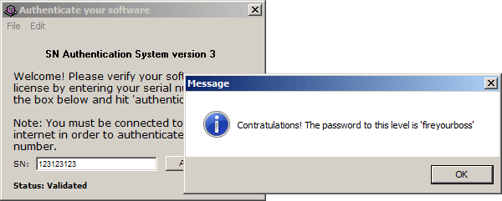

Slide 11
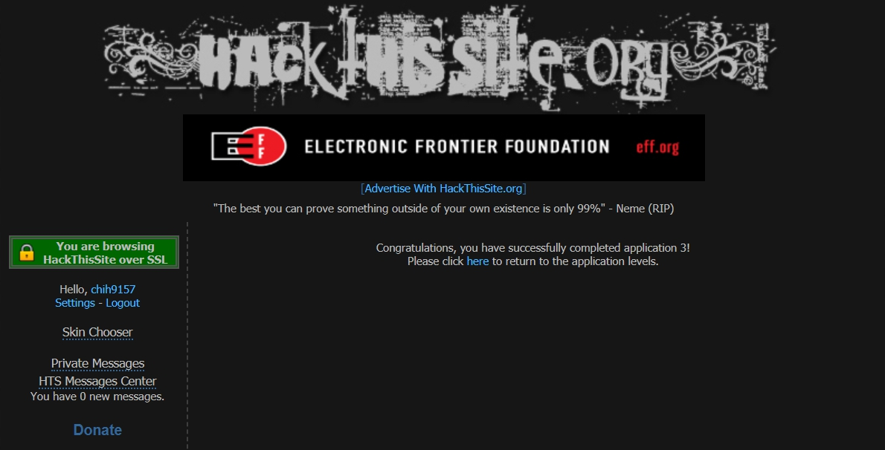

Slide 12
參考資料：
http://sp4hack.blogspot.com/2012/09/hack-this-site-application-3.html
http://www.nullsecurity.org/article/hackthissite_org_application_challenges#app_03w
https://www.youtube.com/watch?v=C5SbCX24_Ug

